Slide 1

Crime Prediction Project
Submitted by:
Anshuman Mathur
Aryan Singh Rajpoot
Akshat Pandey
Roll Number: E23CSEU0680
E23CSEU0678
E23CSEU0666
Bennett University

Slide 2
Introduction
Crime is a critical societal challenge. Predicting and analyzing crime trends can help improve public safety. This project leverages machine learning techniques to analyze historical crime data and predict high-risk areas.

Slide 3
Objective
1. To analyze historical crime data to identify trends and patterns.
2. To forecast future crime rates using predictive modeling.
3. To identify high-risk regions and suggest preventive measures.

Slide 4
Dataset Overview
Dataset: 'Crimes Against Women' (2001-2014)
- Contains data on crime types: Rape, Kidnapping/Abduction, Dowry Deaths.
- Attributes include year, state, crime type, and frequency of occurrences.

Slide 5
Methodology
1. **Data Preprocessing**: Cleaned data for consistency and accuracy.
2. **Data Visualization**: Used Python libraries (Matplotlib, Seaborn) to identify trends.
3. **Predictive Modeling**: Implemented ARIMA for time-series forecasting.
4. **Clustering**: Applied K-Means to identify crime hotspots.
5. **Classification**: Used Random Forest to classify high-risk regions.

Slide 6
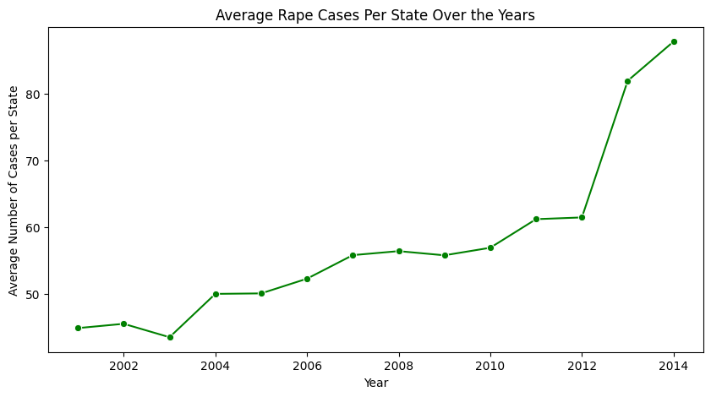
Data Visualization
1. **Line Plot**: Showed the trend of average rape cases per state from 2001 to 2014.

Slide 7
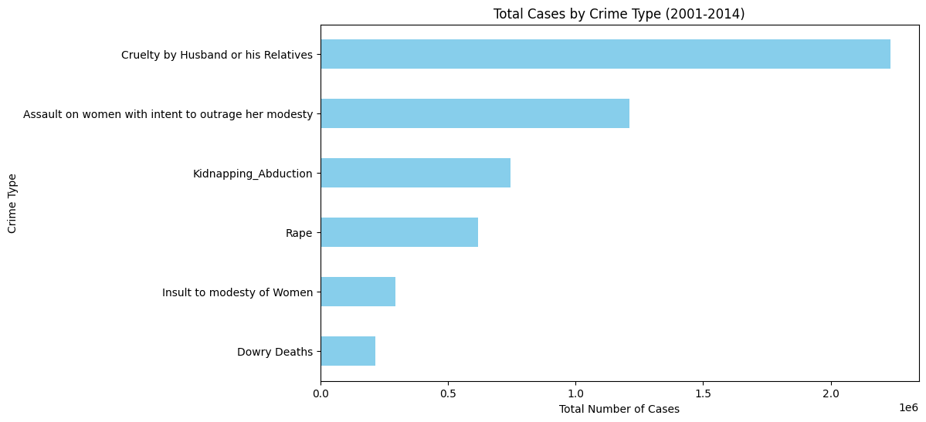
**Bar Chart**: Highlighted the distribution of total cases by crime type.

Slide 8
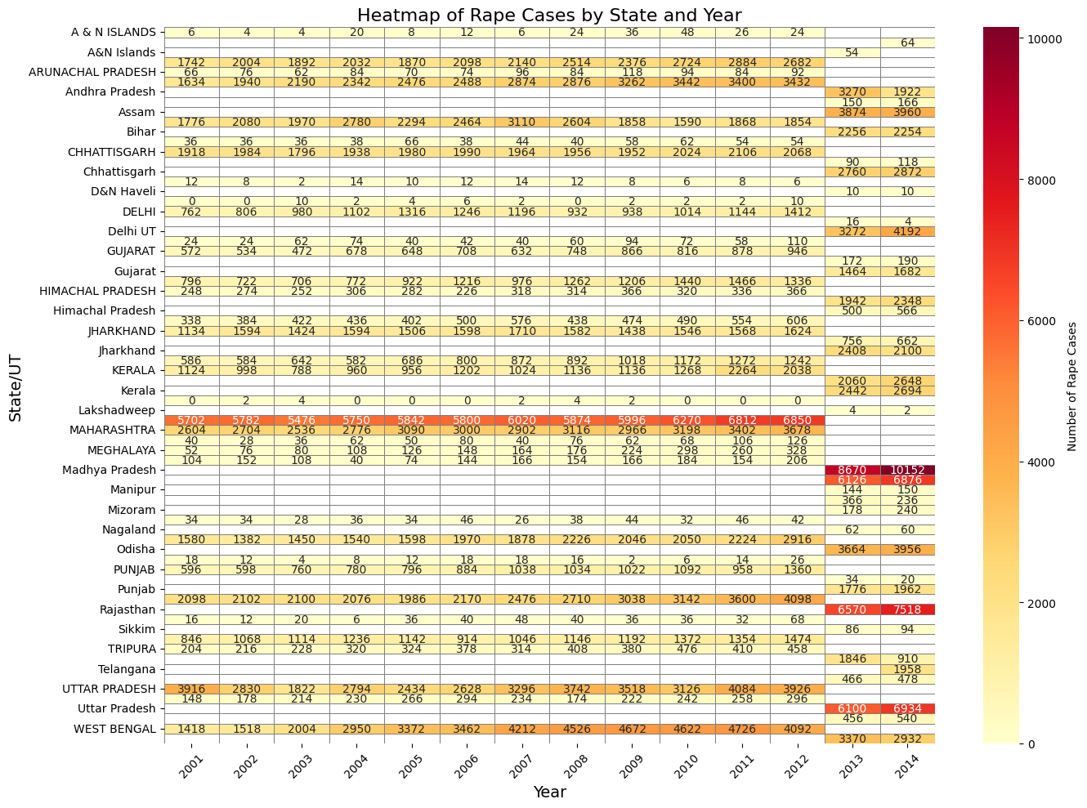

**Heatmap**: Visualized yearly crime intensity across states.

Slide 9
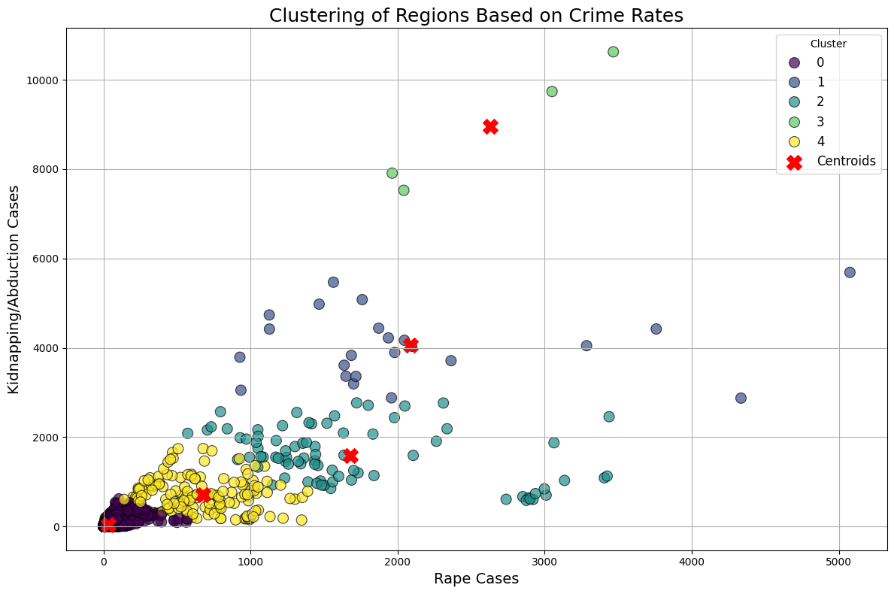
Results
1. **ARIMA**: Forecasted crime trends for Andhra Pradesh with a notable increase in cases.
2. **K-Means**: Clustered regions based on crime intensity, identifying specific hotspots.
3. **Random Forest**: Achieved high classification accuracy for predicting high-risk areas.

Slide 10
Key Insights
1. States like Uttar Pradesh and Bihar exhibit consistently high crime rates.
2. Clustering reveals spatial patterns in crime distribution.
3. Time-series forecasting predicts potential increases in specific crimes.

Slide 11
Future Scope
1. Expand dataset to include recent crime data and demographic factors.
1
2. Develop a real-time crime monitoring system with live updates.
2
3. Apply advanced deep learning models for more accurate predictions.
3

Slide 12
Conclusion
This project demonstrates the potential of machine learning in analyzing and predicting crime trends. The insights obtained can assist law enforcement and policymakers in making informed decisions.

Slide 13
Acknowledgments
Special thanks to the mentors and faculty at Bennett University for their guidance and support throughout the project.

